Slide 1
Validity and Integrity Check in Supply Chain Management using BlockChain
Blood SCM

Slide 2
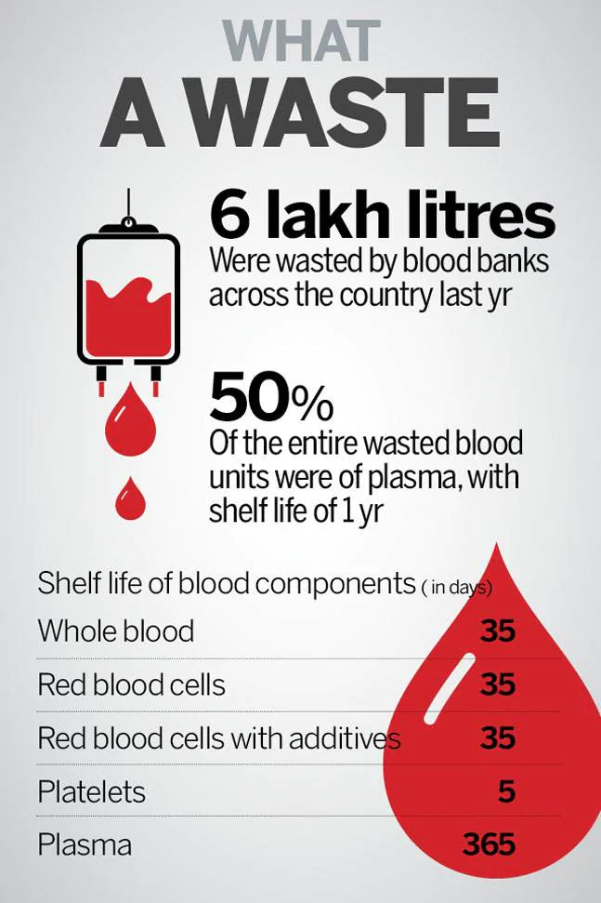
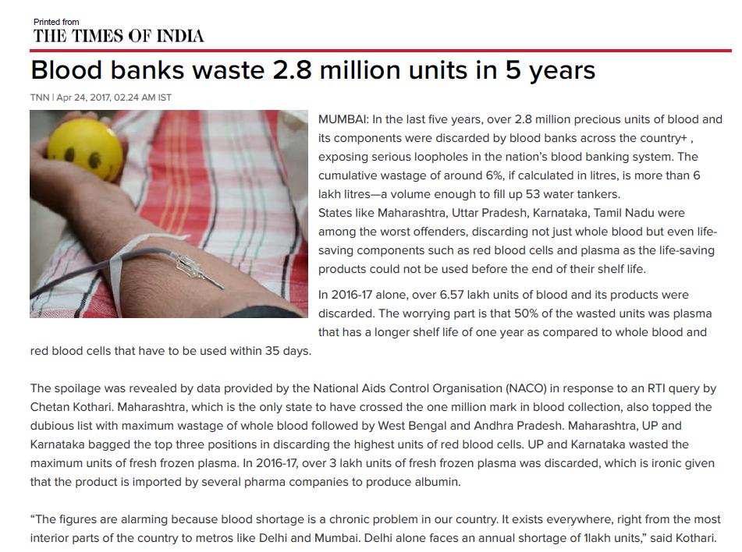
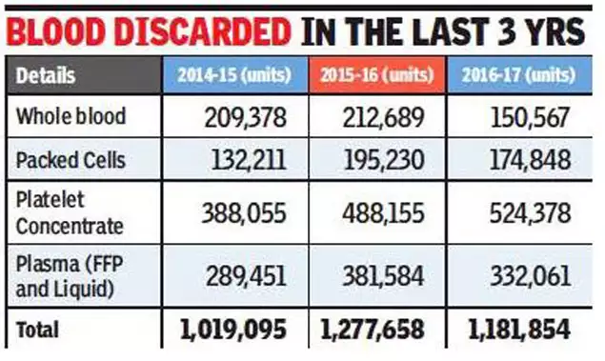
Case Study
Notes:
According to an article by the Times of India, there is a tremendous amount of blood being tagged as ‘waste’, approximating to nearly six lakh litres of blood over five years of span, in Maharashtra itself and is disposed of due to ‘improper coordination between the blood banks and hospitals’ with given justification that they expired prior to their use.
To date there is no artificial replacement for blood.The blood shortage problem is costing thousands of lives annually. There are two key issues contributing to this–
There is a wastage of 20 percent of the blood collected. It usually happens due to poor management of blood distribution.
There are people who don’t participate in the regular donation process because they dislike the lack of transparency on how their donation is used later on. Most of them believe the blood is being misused by blood banks and hospitals.

Slide 3
Challenges in Conventional BSCM
The flow of information from collection to consumption or disposal is not clear. In a centralized blood cold chain, it is difficult to pinpoint the cause of blood disposal in many medical institutions.
Since some blood banks under the centralized blood supply system have jurisdiction over a wide area, the transit time may exceed the golden time in emergencies.
Therefore, the problem is the tracking and allocation of the donation transparently during its useful life. Blockchain can help track provenance in the blood supply chain making it more transparent.

Slide 4
Why BlockChain based BSCM ?
Immutable
Transparency
Traceability
Accountable
Waste Management
Notes:
The inclusion of Blockchain solves the disadvantage of ‘distrust’. By providing total transparency to its users.
Secondly, all the data on a blockchain is stored securely through cryptographic hash function and the ledger is owned and shared by each node in the network. This makes it very difficult for any intruder to manipulate the ledger data, ensuring protection against any possible mutations or fraudulent manipulation of the data stored insofar.
Blockchain helps the system to track the time and place of disposals of blood bags, thus holding entities responsible which will lead to proper management.
Our solution also provides a remedial strategy for improper waste management, which is one of the factors that deter donors away from this system. Using the data uploaded on the BC network, the internal entities can have access to the transparent data and consequently prioritize the process of dispatching the blood bags that are nearing its expiry.

Slide 5
Literature Review
From previous studies in the field of supply chain management, we have gathered and analysed several architectures for tracking various entities using blockchain.
For example, the use of RFID along with blockchain to track agri-food was proposed by Feng Tian. Various other ethereum based systems have been proposed for tracing perishable items such as medicines etc.
Using the verified and proved systems, we have proposed and implemented a SCM system using Ethereum blockchain for tracing and managing Blood.

Slide 6
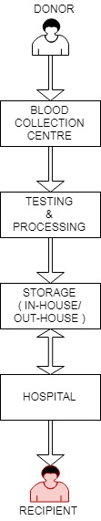
General Flow Diagram (Vein-to-Vein)
Much like any supply chain, the one for human blood involves many bodies, each responsible for a value added task. There are complexities that accompany each stage of the BSCM, often termed the ‘vein to vein chain’.
Upon demand for human blood, blood banks engage in volunteer donor recruitment to generate adequate supply. For example, In colleges, NSS performs this task as well as the collection phase of the chain. The scope of our project considers hospitals as the customers for blood and responsible for communicating demand to NSS (the supplier).

Slide 7
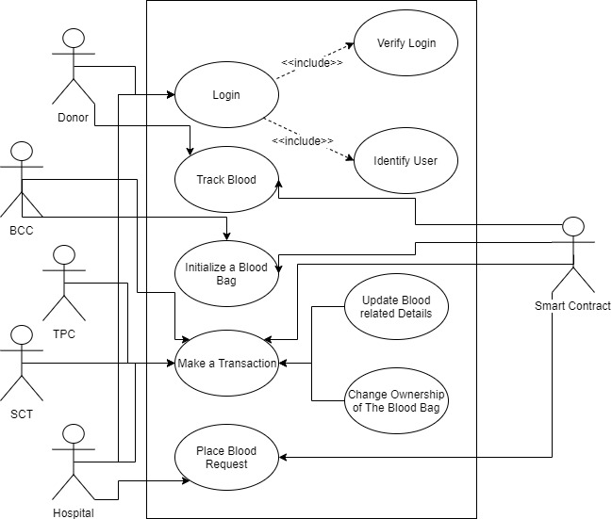
Use Case
Diagram

Slide 8
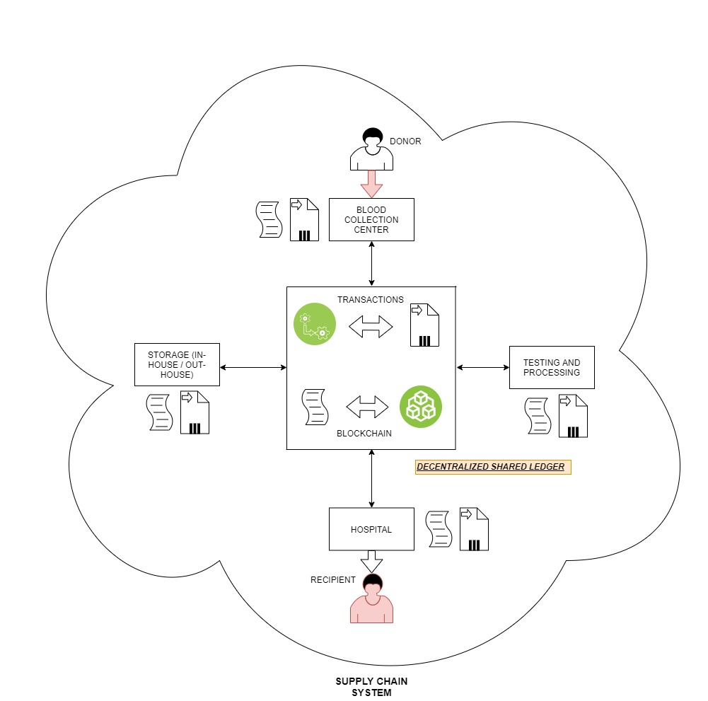
Architectural
Design
Diagram

Slide 9
Certificate for BloodMatch
*Donor ID (Address)
Donor Blood Group
*Blood_Bag ID (Integer)
Donation_Time (Time)
Blood_Splitted (Bool)
Location (Latitude, Longitude)
Expiration (Time)
Owner_name(String)
Owner ID (Address)
Availability (Bool)
Usage_Status
(used/not used/stocked)
*RBC_Bag ID (Integer)
*WBC_Bag ID (Integer)
*Plasma_Bag ID (Integer)
*Platelets_Bag ID (Integer)
Expiration_RBC_Bag (Time)
Expiration_WBC_Bag (Time)
Expiration_Plasma_Bag (Time)
Expiration_Platelets_Bag (Time)

Slide 10
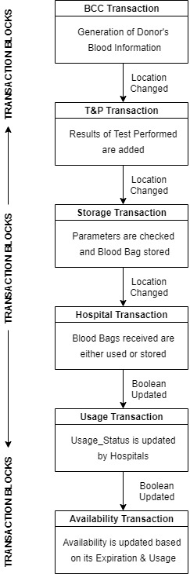
Block Transactions
Blood Donation :
A certificate will be created for donated bags which can be tracked.
Blood Collection Centre :
Addition of blood bag with a unique Bag_id field and parameters whenever a blood bag will be donated.
Testing & Processing :
Splitting of Blood to RBCs, WBCs, Platelets, Plasma.
Addition of Expiry & Unique ID fields for components of Blood.
Storage (In-house/Out-house) :
Temperature Regulation & Preservation of Blood Lifetime.
Hospital :
Manual Updation for Blood Availability, Usage Status & emergency calls.
Expiration & Change in Ownership Status will be validated in every stage.

Slide 11
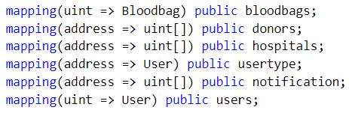
Methods and Implementation
Our system primarily uses these 6 mappings in solidity to keep an easy track of the details and latest transactions.
Notes:
Our algorithm, as previously stated is heavily dependent on the specific features of solidity, such as the ‘Smart Contracts’.
• Bloodbags –This is a very general list of bloodbags. It stores and returns the entire
structure(object) of a Bloodbag, whose ‘id’ will be equal to the uint (integer) provided to
the mapping.
• Donors – The Donors mapping will store and return an array, consisting of the bloodbag
id(s) corresponding to each and every donor for a particular Blood Collection Center.
Based on the address of the Bank provided, the list of donors for that center will be
retrieved.
• Hospitals: This mapping stores and returns an array, consisting of the bloodbag id(s) that
are currently in possession and owned by the given address’s hospital.
• Usertype – This is the type of mapping used for administrative purposes. It is used
specifically to provide the client’s information, such as the type of user. For example –
1. ‘1’ is for Donor
2. ‘2’ is for Blood Bank
3. ‘3’ is for Hospitals
Usertype: This ‘usertype’ mapping helps the system to dynamically recognize the type of client,
who is visiting the webpage. Based on the usertype and the address of the client, we can
provide a fluent access to the data belonging to the user/client.
• Users – Lastly, the ‘users’ mapping is used to contain the list of entire user network,
including the donors, hospitals, and the banks. It helps to keep the access of id of every
user in a simplistic yet efficient manner.

Slide 12
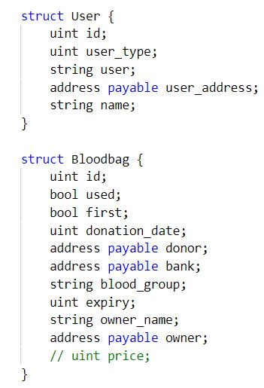
Methods and Implementation
Every system has to use a type of data structure that is efficient enough to handle the application of the system and suffice with its use-case. Our system comprises of two different ‘structs’
User – The user struct is a skeleton holding certain parameters for each and every user that is registered on our network.
Bloodbag – The bloodbag struct holds the information unique to each and every bag created/donated to the blood bank, that enters into our network.
Notes:
Every system has to use a type of data structure that is efficient enough to handle the application
of the system and suffice with its use-case. Our system comprises of two different ‘structs
’.
• User – The user struct is a skeleton holding certain parameters for each and every user
that is registered on our network. These value are –
1. Id - Used for listing and identification purposes.
2. user_type – It helps denote the category of the user (Bank/Hospital/Donor).
3. user – Contains the description of the given user.
4. user’s network address – The blockchain network enabled address of the user.
5. unique name – For listing and Identification Purposes.
• Bloodbag – The bloodbag struct holds the information unique to each and every bag
created/donoted to the blood bank, that enters into our network.
1. Id - Used for listing and identification purposes
2. Donation date – It is factored in for the authenticity of the bloodbag created. It
helps in calculating the expiry date of the blood bag.
3. Address (Donor) – Used to maintain the link to donor, inorder for the donor
certificate’s tracking.
4. Address(bank) – Used for maintaining the relation to the bank that has generated
the bag.
5. Blood Group – Used for Medical purposes.
6. Expiry – Used for secure medical Purposes.
7. Owner name – Used to track the current dynamic ownership/holder of the bag in
the system.
8. Address Owner – Used to track the purchase details for the owner where the
payment is transacted

Slide 13
Major Functions
The functions used by the network are:
Admin Functions: These are the functions designed for the admin panel to carry out the backend tasks. Namely:
createBank – The admin will assign the registration ‘creation’ of every blood bank.
createHosp – The admin will handle the registrations for every hospital that get affiliated with our network.
System Functions: The system will perform certain desired operations for the registered entities. For example
createBloodbag – The banks on receiving the the donations made by the donor, will log in to their systems and register the details on the blood bag.
h_placeOrder – The hospitals, when in need of new blood bags, will order for the purchase of blood bags from the nearby Banks and other Hospitals. This transaction will be validated and performed securely through this function.
Notes:
The system administrator is responsible for handling the inclusion and removal of banks and hospitals.
For instance: if a new blood bank is coming up in a disaster prone area then, the admin can register it into our system using the createBank function and similarly for the new hospitals.
System Functions are the fucntions that assist the added entities (like banks and hospitals) to properly manage their inventory and keep it updated online in real-time.
Instances of system fucntions include: placing the order of the blood bags from one entity to another. For example. A hospital placing order for 2 blood bags of blood group A to a nearby bank. The entire ether payment transaction is secured using the blockchain network and is always real-time.

Slide 14
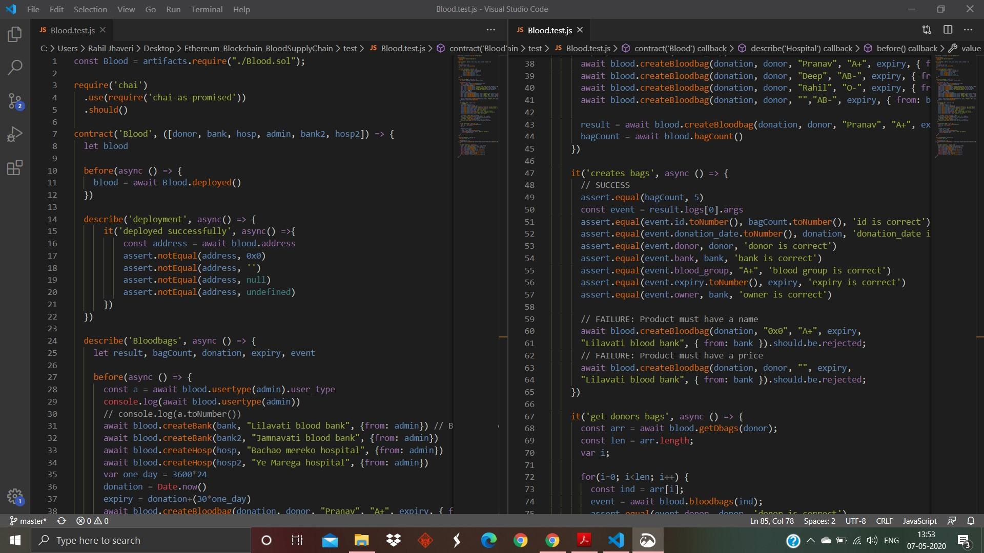
Deployment Test using Mocha and Chai
Notes:
Mocha.js:
Mocha is a feature-rich JavaScript test framework running on Node.js and in the browser, making asynchronous testing simple and fun. Mocha tests run serially, allowing for flexible and accurate reporting, while mapping uncaught exceptions to the correct test cases. Hosted on GitHub.
Chai.js:
Chai is a BDD / TDD assertion library for node and the browser that can be delightfully paired with any javascript testing framework.

Slide 15
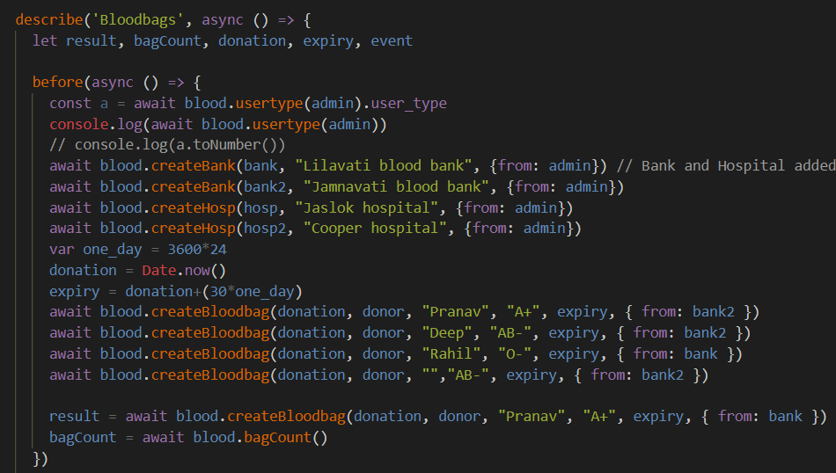
Creating Test Data before performing tests

Slide 16
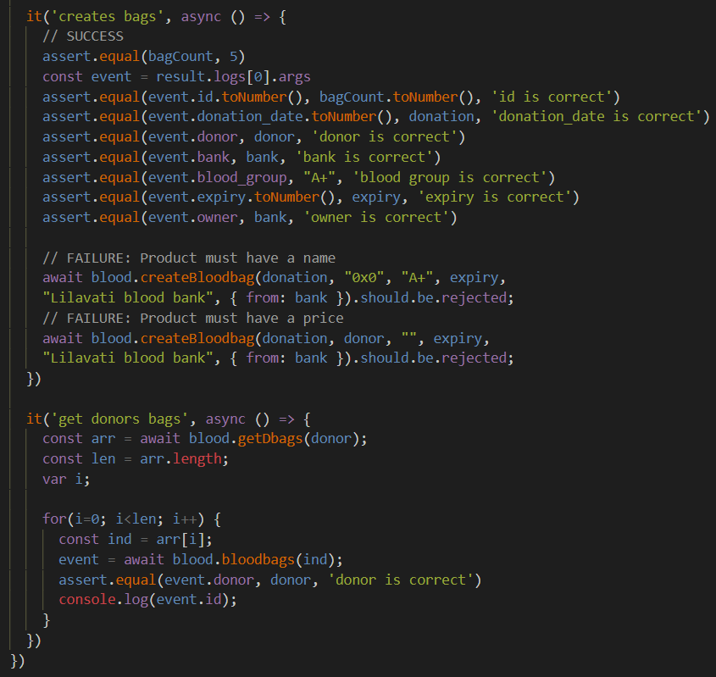
Tests:
Bag Creation
Fetching Donor’s Bags
Notes:
As in the previous slide, we added a number of bloodbags to the system, we now check for the integrity of the data stored on the network for those bags. We specifically check for the total count, donation dates, blood groups, ownerships and other various parameters as stated in the structure of a bloodbag.
Once that is complete we check for the details of the bags donated by a particular donor. After fetching the details of the donor, we verify that the bloodbags donor id matches with that of its actual donor.

Slide 17
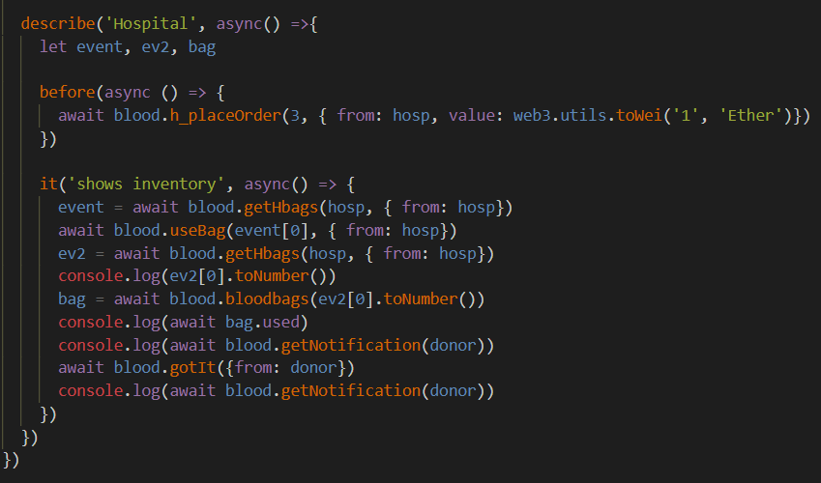
Placing an order before testing.
Test:
To display local inventory of a Hospital.
Notes:
Inorder to test the working of the inventory of a hospital, we first created a test to place an order for a bloodbag for the hospital. Which, in turn will show up in its inventory once the bag is successfully purchased.

Slide 18
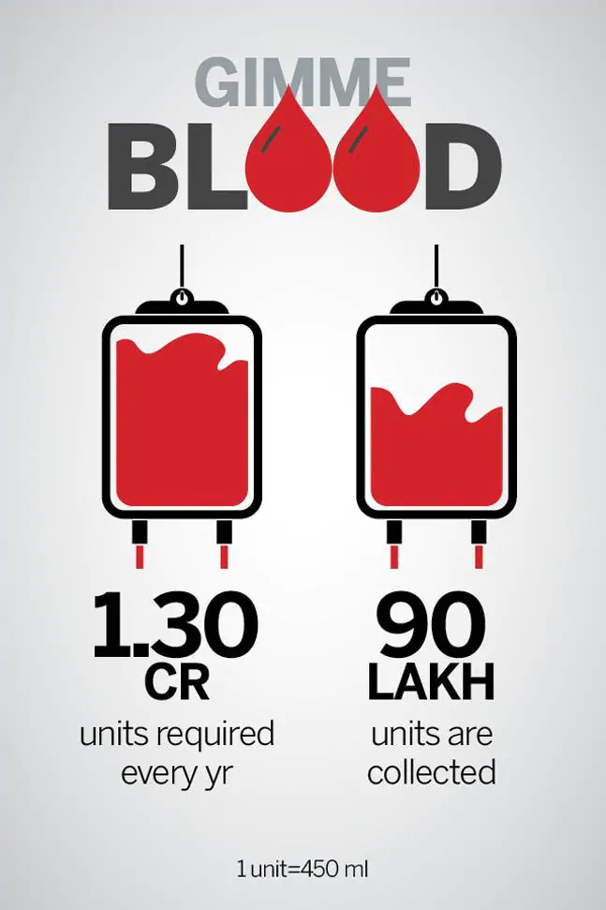
Conclusion and Future Scope
In our proposed model we have improved the SCM by implementing it using Blockchain. It takes care of reliability, traceability, and immutability.
The security of transaction and waste management factors have been taken care of by including smart contracts and deploying near to expiration blood first processes respectively.
Since the whole process is transparent as a shared ledger is maintained, donors can track their donated blood bags. It would make a great impact on increasing the trust factor and consequently, the donation rate. H2H & B2H facilities have been included to supply blood during the golden period.
Future Scope:
Handle splitting of the Blood into its constituent components.
Visualize the data collected and analyze it for better tracking.
Notes:
To Conclude, our system overall is designed specifically to cater the needs of providing rigidness and reliability in the aspects of trust and working of the entire supply chain. And it is made possible with the inclusion of blockchain. As aforementioned, it takes care of reliability, traceability and immutability.
Using the feature of smart contracts we can successfully create a secure method for payment transactions and prioritizing the dispatch of blood bags with respect to their date of expiration is a factor which helps us alleviate the issue of wastage of blood.
As for the future scope, we aim to provide 2 more features:
On researching thoroughly regarding the entire process of blood donation, we came across the process of spitting the blood into its core components like: wbcs, rbcs, and platelets (which actually help in increasing the expiration of a bloodbag). We aim to provide support for handling the splitting of the blood.
Secondly, banks and hospitals can analyze their work and structure much precisely based on the statistics recorded. We aim to provide a data visualizing feature that will help in analyzing the productivity and recognizing the faulty entities, if any in.

Slide 19
Thank You.
Mentor : Dr. Aruna Gawade
Pranav Gor 60004160032
Deep Gosalia 60004160033 Rahil Jhaveri 60004160042

